Slide 1
NEW MEXICO GENERAL SERVICES DEPARTMENT
STATE PURCHASING
STATEWIDE PRICE AGREEMENT REPORTING

Slide 2
2006 New Mexico Statutes - Section 13-1-95 — Purchasing division; creation; director is state purchasing agent; appointment; duties.
13-1-95. Purchasing division; creation; director is state purchasing agent; appointment; duties.
(1) recommend procurement regulations to the secretary;
(2) establish and maintain programs for the development and use of procurement specifications and for the inspection, testing and acceptance of services, construction and items of tangible personal property;
(3) cooperate with the state budget division of the department of finance and administration in the preparation of statistical data concerning the acquisition and usage of all services, construction and items of tangible personal property by state agencies;
(4) require state agencies to furnish reports concerning usage, needs and stocks on hand of items of tangible personal property, and usage and needs for services or construction;
(5) prescribe, with consent of the secretary, forms to be used by state agencies to requisition and report the procurement of items of tangible personal property, services and construction;
(6) provide information to state agencies and local public bodies concerning the development of specifications, quality control methods and other procurement information; and
(7) collect information concerning procurement matters, quality and quality control of commonly used services, construction and items of tangible personal property.

Slide 3
Reporting Deadlines
Quarterly Reporting Report Date
July-September October 5
October-December January 5
January-March April 5
April-June July 5
Designated CPO’s for each agency/local public body should be registered with NM State Purchasing Division and have access to the reporting portal
More than one person from an agency may have access to the portal. This request will need to come from the agency CPO

Slide 4
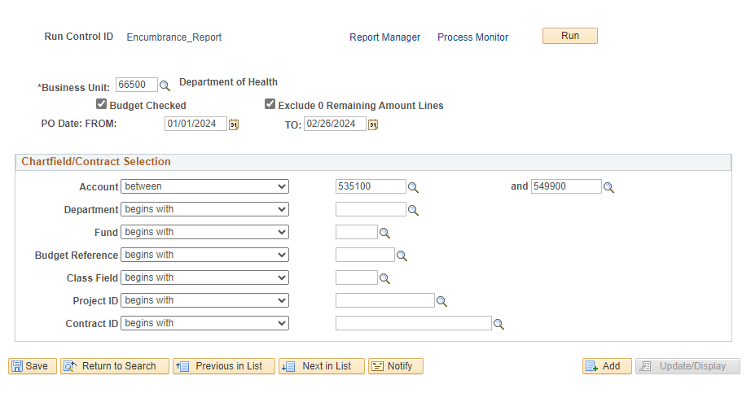
Where to obtain information in SHARE
SHARE encumbrance report
Purchasing
Purchase Orders
Reports
NMS Encumbrance Report
Add a New Value
Name the report Encumbrance Report
Change to your business unit

Slide 5
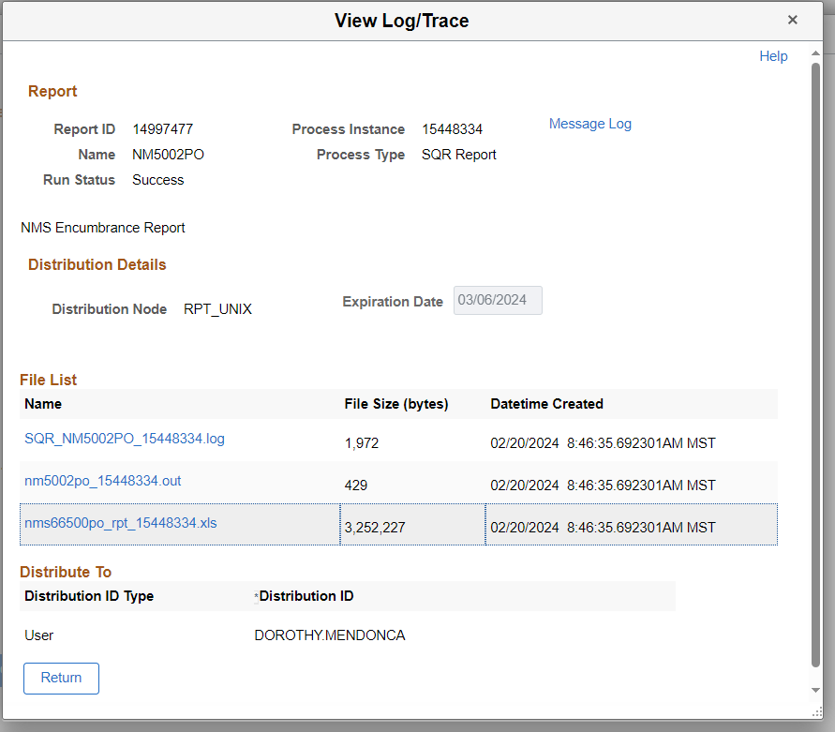
The report will give you an excel spreadsheet. Filter to have access to the contract column (column AE) filter all SWPAs. This information will be used to transfer to our reporting portal.

Slide 6
The spreadsheet result of this report will indicate in column AE any contracts
Filter the spreadsheet to have the results of the SWPA contracts
SWPA in most cases end with a letter configuration example: AC, AD, AF (10000002100082AD) or may look like 00000002000095
Agency specific contracts will contain the business unit numbers (24 350 0002 00013 00) and DO NOT need to be included in the reporting. ONLY SWPA contracts
Input/Transfer all SWPA to the State Purchasing Portal

Slide 7
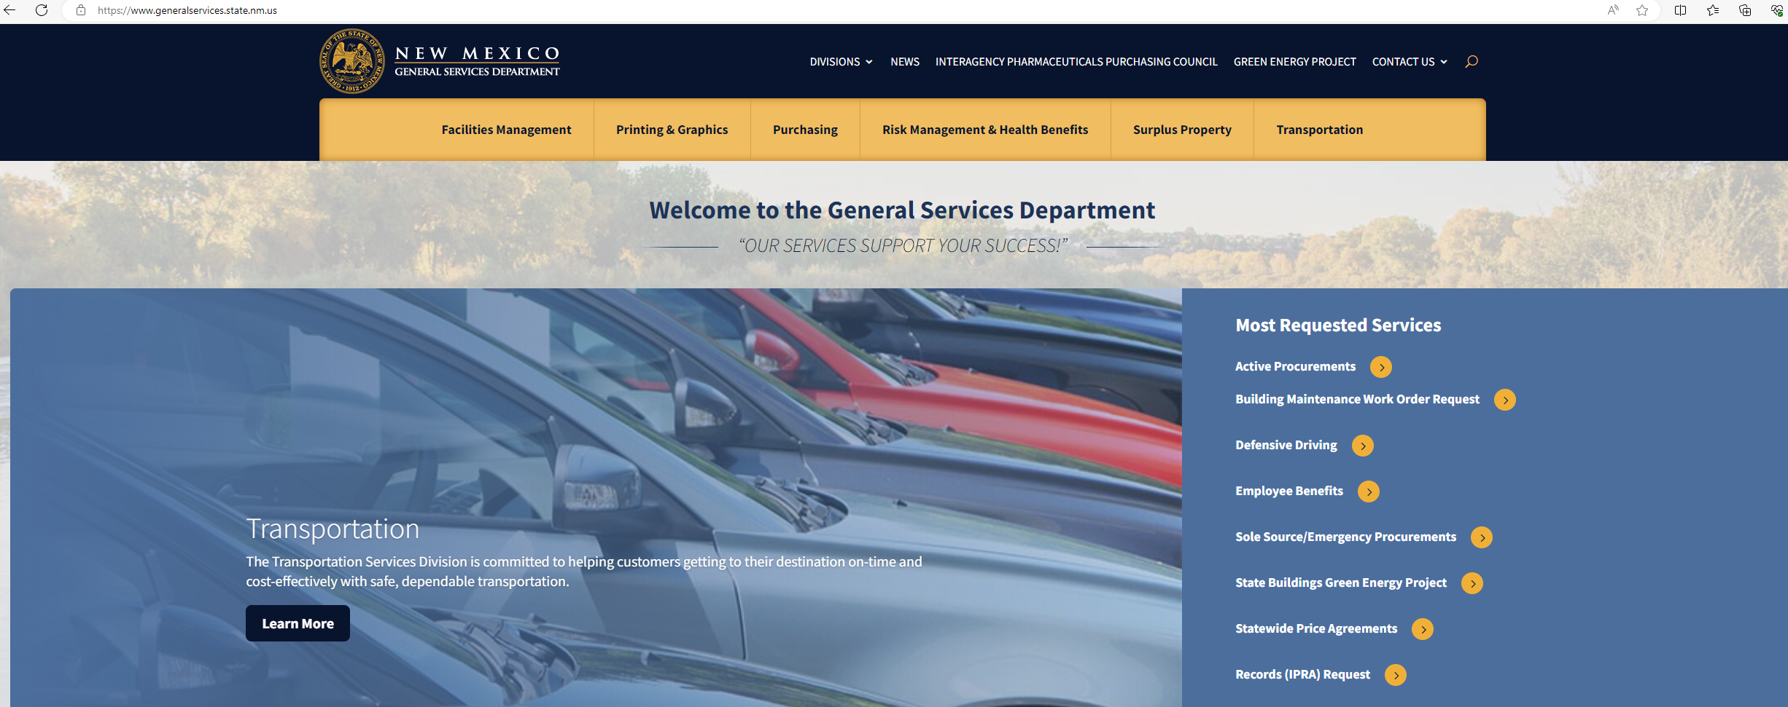

Slide 8
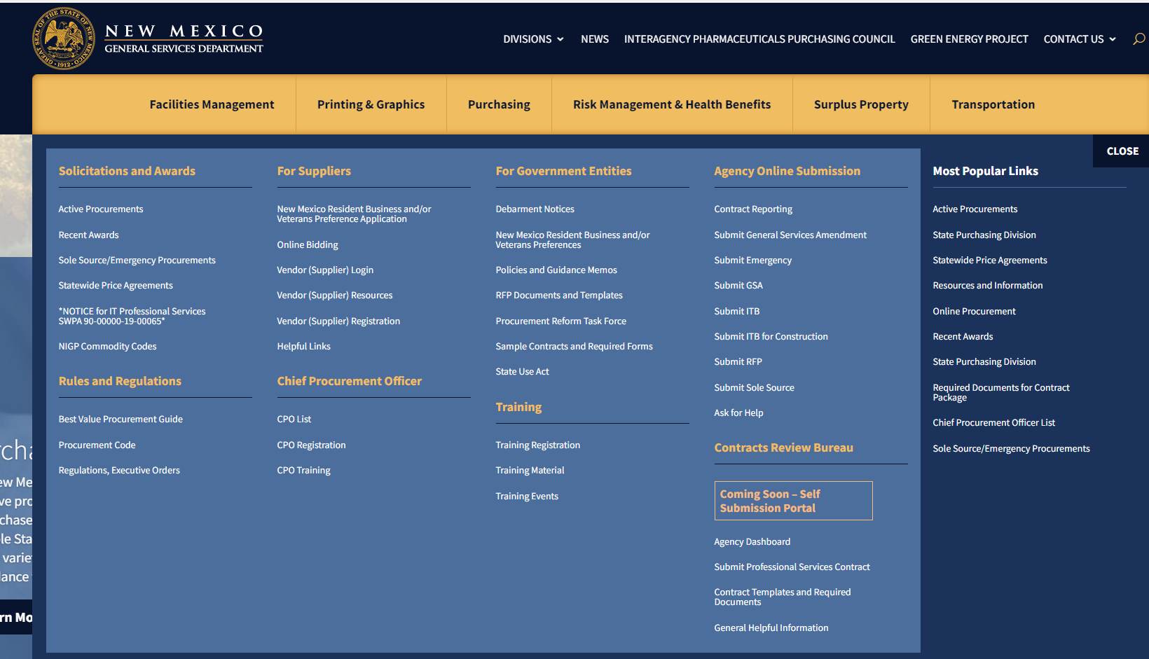

Slide 11
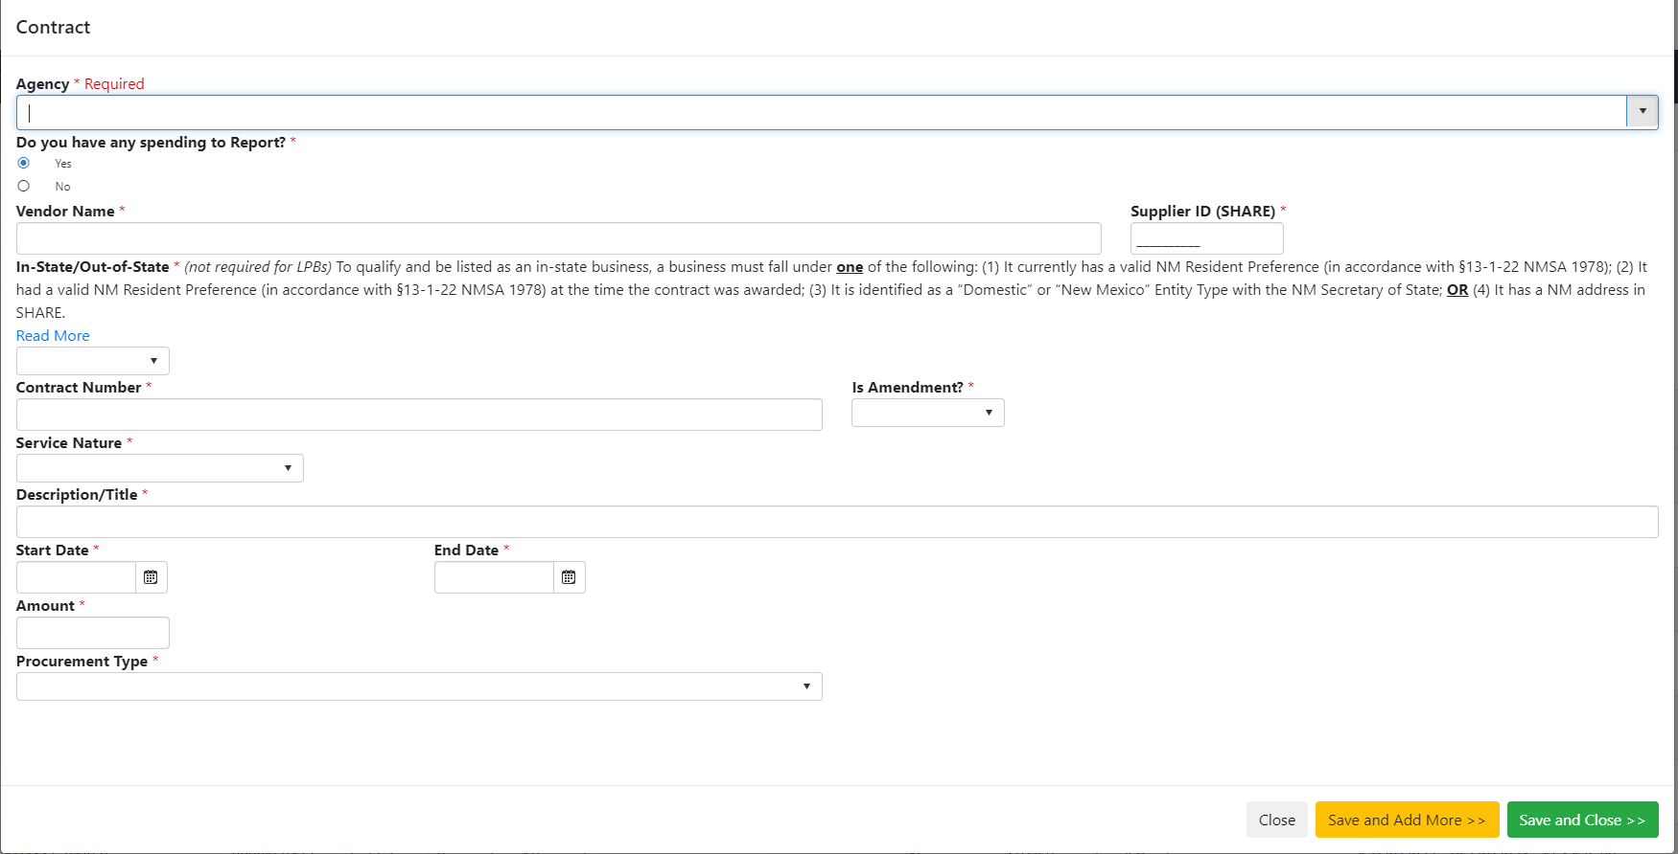

Slide 12
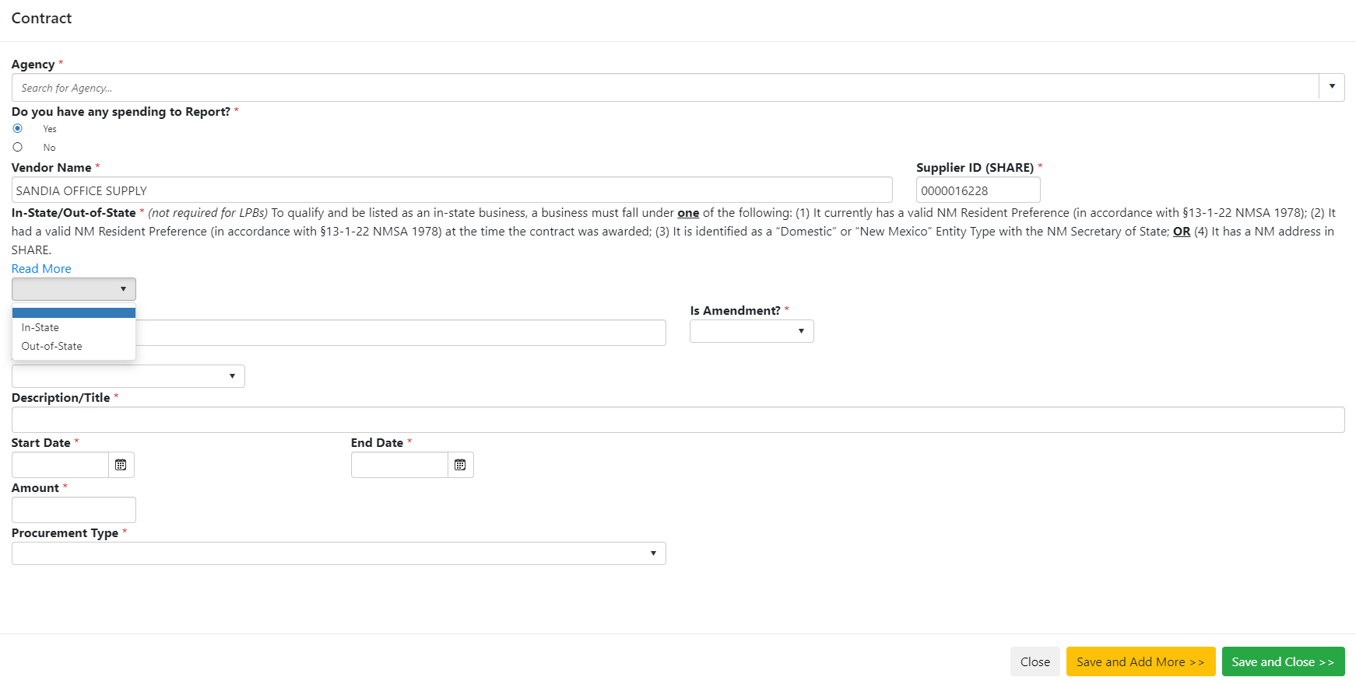

Slide 13
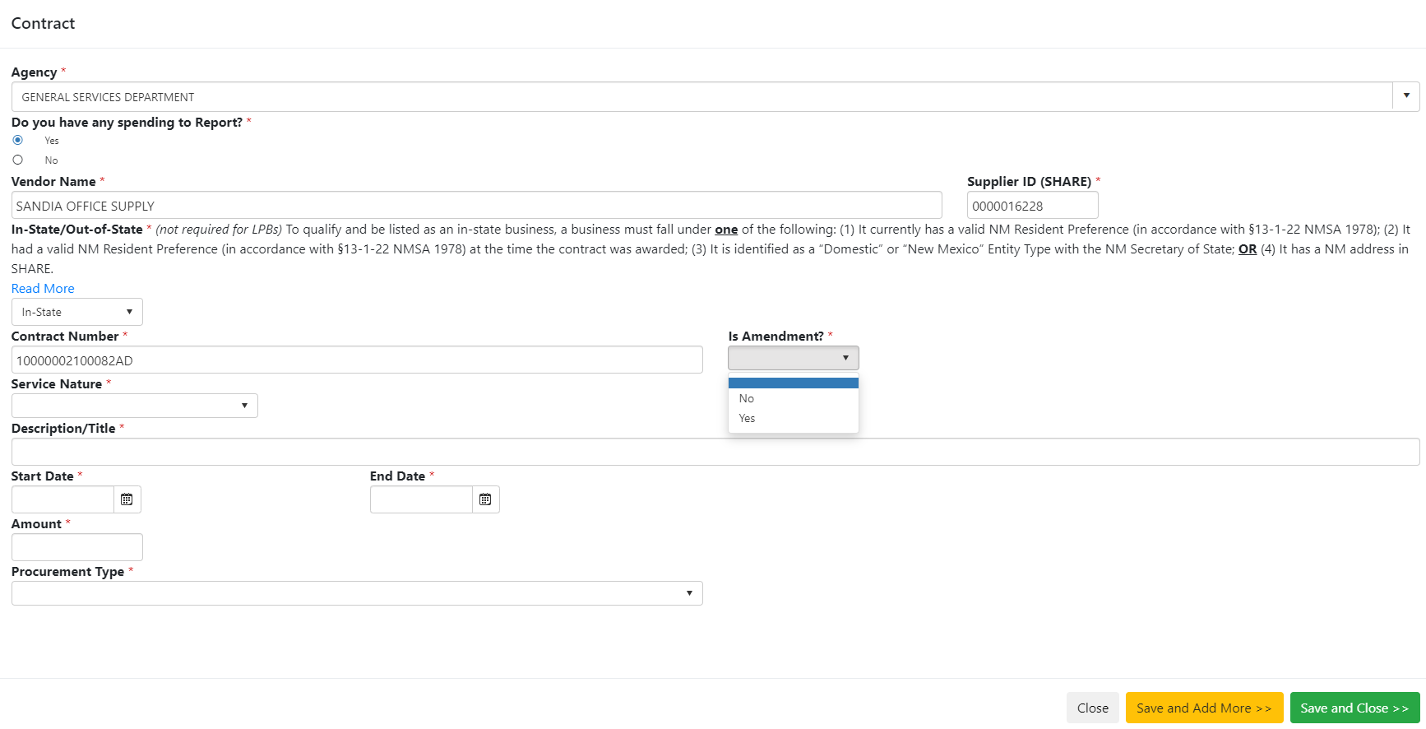
This is the SWPA number
The original entry will be NO. Should the amount need to be changed to reflect actual spend. This would indicate YES to an amendment.

Slide 14
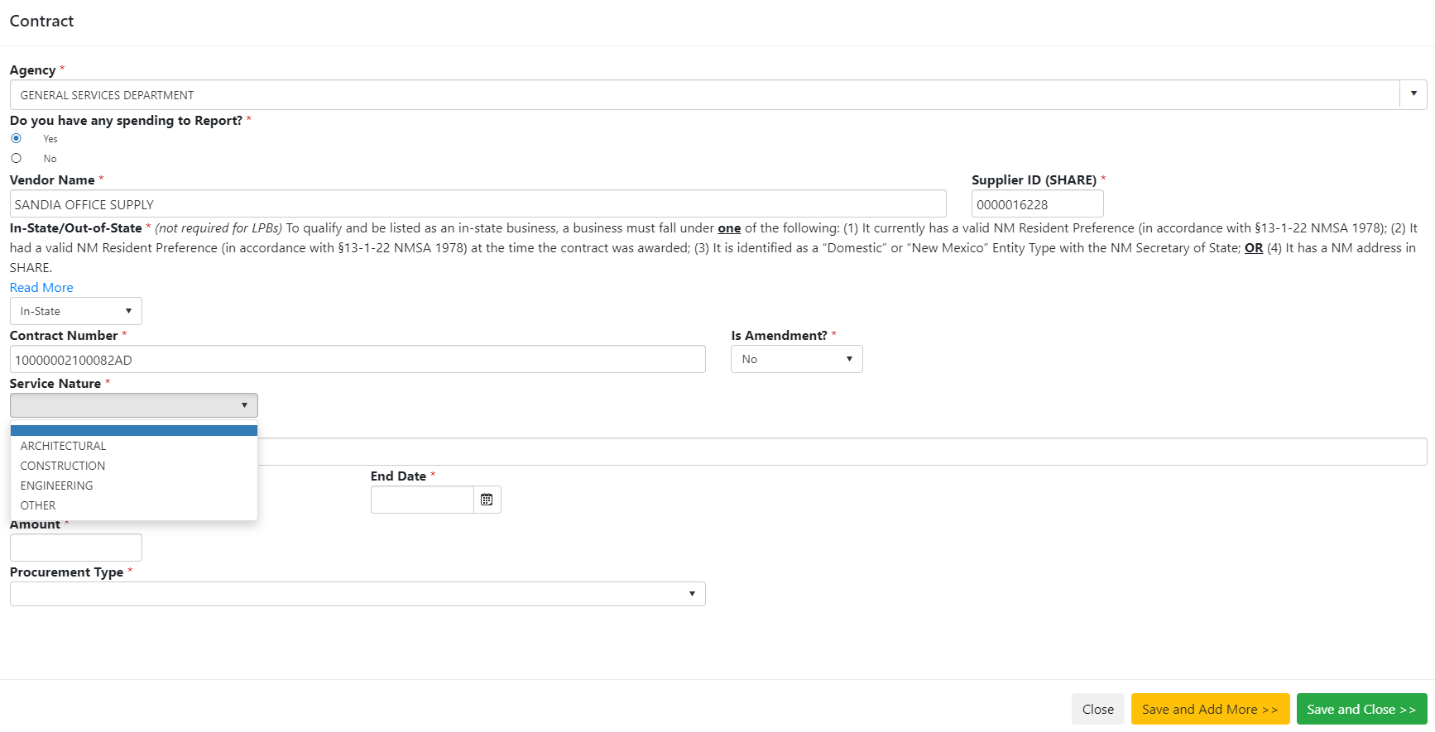
Other is chosen for all other SWPA to include office supplies, copy machines, etc.

Slide 15
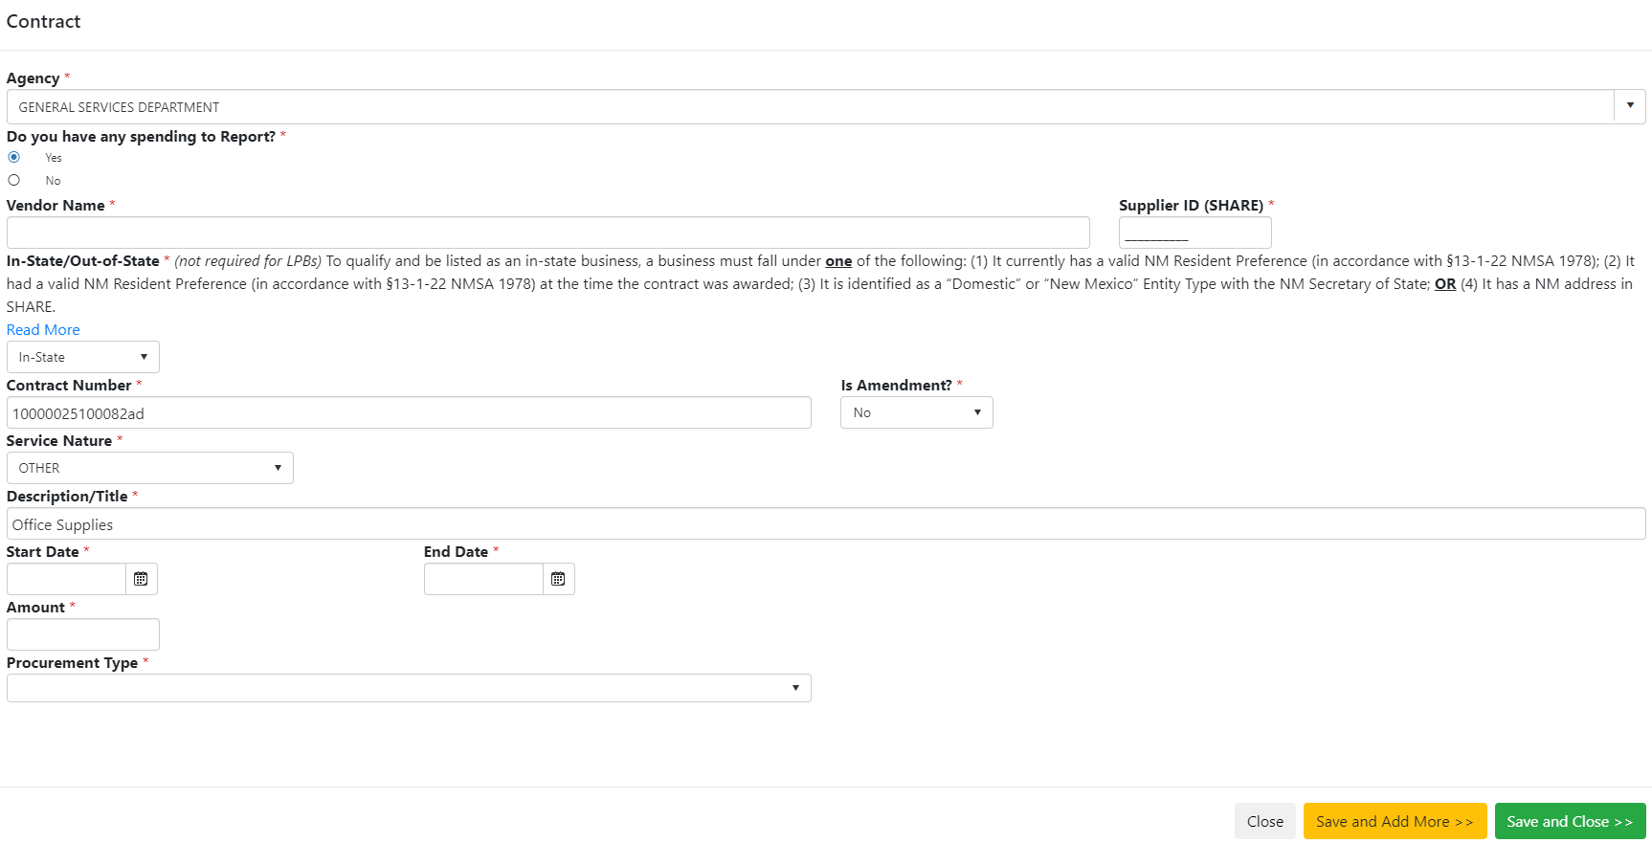
Add brief description

Slide 16
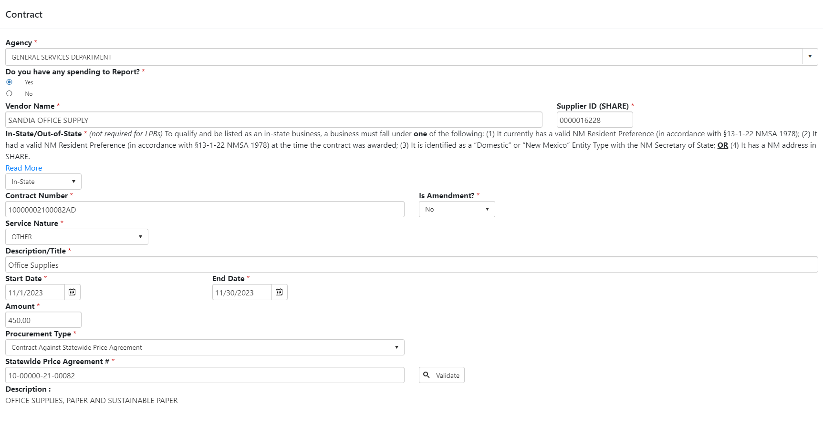
The start date is the date of the purchase order is created or the start of the contract
End date is the date the invoice is paid or the end date of the contract
The amount is the amount of the purchase order/contract. This amount can be amended if needed to reflect the actual amount of spend

Slide 17
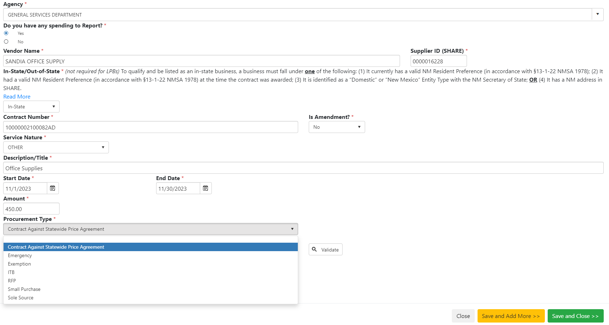
Procurement type should be Contracts Against Statewide Price Agreement

Slide 18
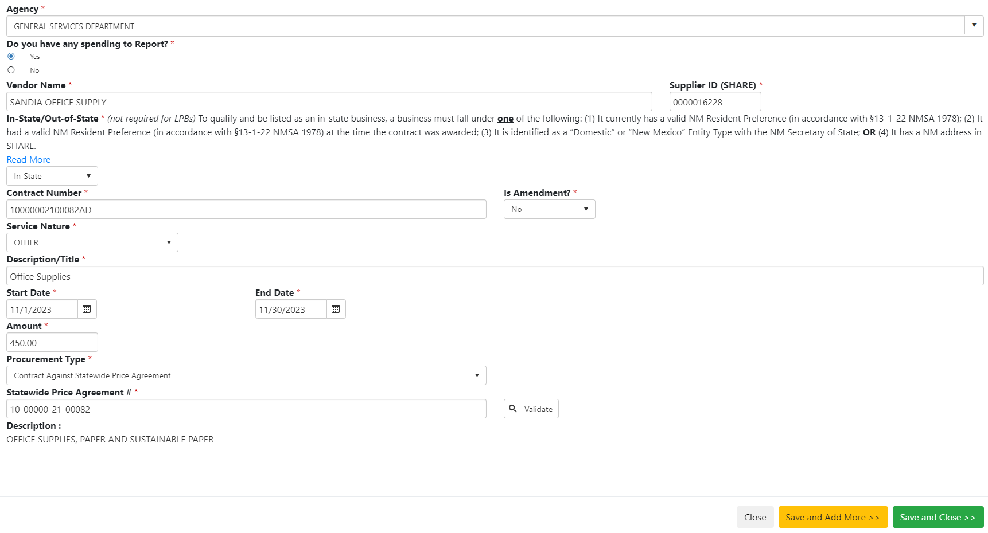
1-The SWPA number will need to be entered manually
2-Validate and the Description will update automatically
3-Save and Close

Slide 19
SPD Contacts for reporting questions
Francine Wagner (Francine.Wagner@gsd.nm.gov)
Natalie Martinez (Natalie.Martinez1@gsd.nm.gov)
Dorothy Mendonca (Dorothy.Mendonca@gsd.nm.gov)

