Slide 1
Risk Management Advisory Board State of New Mexico General Services Department
April 20, 2023
2:00 – 3:30 p.m.
https://www.generalservices.state.nm.us/risk-management/rmab/

Slide 2
Risk Management Advisory Board
General Services Department
Office of the Attorney General
Office of the Superintendent of Insurance
Department of Finance and Administration
Legislative Council Services
And other appointed persons
Meeting Agenda
Thursday, April 20, 2023 | 2: 00- 3:30 pm
Conducted online via Microsoft Teams (see GSD website for link)
 | Agenda Item | Action
1. | Welcome Call to Order Roll Call
2. | Approval of the Agenda | Vote
3. | Approval of December 15, 2022, Meeting Minutes | Vote
4. | FY24 Certificates of Coverage | Discussion
5. | Welcome and Legislative Recap | Discussion
6. | PAC, Legal, WC Bureau Chief’s Presentation | Discussion
7. | Board Discussion Items | Discussion
8. | Public Comments | Discussion
9. | Next Meeting – September 28, 2023 | Discussion
10. | Adjourn

Slide 3
Certificate of Coverage FY24
Letter of Administration – Header Updated
- No modifications for FY24
Liability Certificate of Coverage – Header Updated
- No modifications for FY24
Property Certificate for FY24 – Header Updated
- Reviewing leased heavy equipment
- Employee property required for job
- Added exclusion for storage tanks (risk transfer)
- Using comps for APD total losses

Slide 4
2023 Legislative Recap
SB16- Signed by Governor Lujan-Grisham
Moves the EBB-eight positions to the newly named Health Care Authority Department

Slide 5
Workers’ Compensation Bureau
Administers Workers’ Compensation benefits for all state agencies, higher education facilities and local public bodies. FY22 exposure survey showed 21,922 full time employees.
All claims must be filed via secure electronic portal online.
Medical benefits for reasonable, necessary and causally work related injuries are lifetime with no deductibles.
Indemnity benefits for compensable injuries paid at 66 2/3rd of the average weekly wage.
Disability impairments paid on whole person and scheduled body parts for 500-700 weeks.
Manual processing of non-mapped bill payments, bulk paid pharmacy and litigation assignments.
Continue to process and provide user experience updates and quarterly releases on the PCIS Claims Vision RMIS system.
• IT working with PCIS on functionality of all reporting interfaces.
• Temp employee working on WCA EDI, FROI/SROI issues.
• Temp employee working on Section 111 Medicare reporting to Centers for Medicare services.

Slide 6
Workers’ Compensation Bureau
• Medical bill review through Genex continues to render significant savings utilizing their PPOs in addition to the maximum allowable fee schedule.
• Temp employee working on Genex Explanation of Review errors.
• Maintain high production levels of claim file workload activities with eight adjusters and four support staff.
• Workers Compensation Bureau currently at a claim volume of 1101 combined Medical and Indemnity open claims.
• Litigation files assigned to contract counsel.
• Severe claims assigned to Medical Case Management to facilitate maximum medical improvement and claim closure.
• Insurance premiums are based on a 5 year loss history.
• Subject to New Mexico Workers’ Compensation Laws and Regulations.

Slide 7
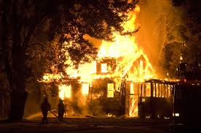
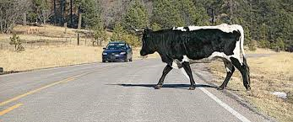
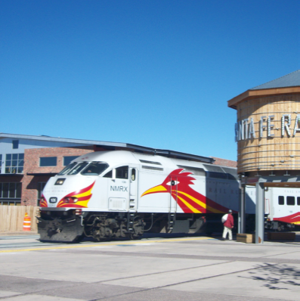
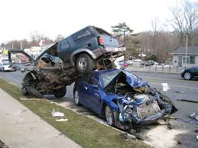
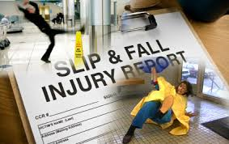
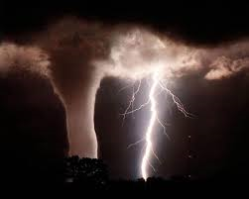
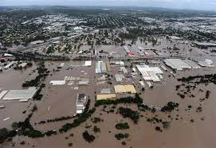
Property and Casualty Bureau

Slide 8
Property and Casualty Bureau
Serves to manage and protect the Public Liability Fund §41-4-23 and the Public Property Fund §13-5-1.
Efficient, responsive claim service that ensures consistent results across state government.
Paperless “green” operations from open to close.
Consistent application of the liability and property certificates of coverage to ensure audit ready files.
N.M. licensed multi-line staff adjusters.
Work with our reinsurance partners and vendors to expedite the claim process through catastrophic events.
Educate our agencies on insurance principals and processes.

Slide 9
Property and Casualty Bureau
Advertising the RFP for I.A.s for our 4 year contracts
As of April 12, 2023: 2,866 active open claim files
FY23 To Date: 1,486 Claim Submissions
1,021 Open Civil Rights / 1,249 General Liability Files
86 Open Property Files
Nearing settlement of subrogation with PHI Helicopter for damages sustained at UNMH in 2014

Slide 10
Legal Bureau
Co-sponsored a Continuing Legal Education (CLE) seminar in December with the Defense Lawyers Association
Advertising the Legal Services Request for Proposal (RFP) for fiscal years 2024-2028
Public Liability Fund (357) nearly exhausted
$27,804,137 expended to date
$348,862 left in fund 357
A $10,000,000 BAR has been submitted to finish the fiscal year
Advertising 1 open paralegal position

Slide 11
Retirements at Risk Management Division
Charlene D. Urban – 30 years of service with the State of New Mexico almost 23 years at RMD/WCB.
Mary Jo Lujan – 25 years with the State of New Mexico in RMD. Served in various positions in RMD since 3/23/1998.

Slide 12
Next Meeting
RISK MANAGEMENT ADVISORY BOARD
Proposed Meeting and Prep-Meeting Schedule for 2023-2024
RMAB Meetings
DATE | LOCATION | BUREAU CHIEF PRESENTATIONS
Thursday, September 28, 2023 | Via Teams | Finance
Thursday, November 16, 2023 | Via Teams | Alternative Dispute Resolution I, Loss Control
Thursday, March 28, 2024 | Via Teams | Property and Casualty (PAC), Legal, Workers’ Compensation
Thursday, May 23, 2024 | Via Teams | Alternative Dispute Resolution II

