Slide 1
Modification Process to State Owned Properties
Facilities Management Division of General Services Department
2542 Cerrillos Rd., Building T-187
Santa Fe, NM 87505
A guide to the:

Slide 2
WHEN DO I NEED TO REQUEST A MODIFICATION?
ANY changes or alterations to the existing structures or modification to the property and the change is $60,000 and under (not a work order(Santa Fe Only) or regular maintenance), MUST be approved by GSD/ FMD.
GSD/ FMD has established a Modification Committee that is responsible for reviewing and approving all changes to State-owned properties
Projects OVER $60,000 contact Capital Projects Bureau, Martin Kuziel 505-795-0116

Slide 3
EXAMPLES OF MODIFICATIONS TO STATE OWNED BUILDINGS
Agency is responsible for completing a Modification Request form for any of the following changes:
Space Renovations: Minor work
Walls/ partitions- additions, demolition and changes to existing floor plans layouts, includes addition or removal of system furniture, cabinets, cubicles. Changing wall paint color-approved state office color is Birch White – existing O/M stock. Door, hardware and window changes and signage.
Finishes: Tile and Carpet addition or change.
Furnishings: CID requires furniture installer to be licensed with a NM GS-29 and apply for a permit before work is started.
Electrical work: Changes/ upgrades, additions of new partitions or walls, ceiling modifications with lighting and additional electrical service. All new electrical work should include an analysis of the existing electrical loads. This includes new circuits, and additional wall outlets and lighting.
Plumbing Work: Replacement or upgrades to existing toilet rooms, finishes and fixtures. Interior and exterior (irrigation)
HVAC: Any modifications to the existing HVAC supply and return. Modifications to existing supply required for new room layouts.
Security: Cameras badge access and modifications to IT closets. Any modifications to the existing system. Fire alarms and suppression system modifications.
Exterior Building modifications: Exterior color, windows, fencing, lighting and parking lot upgrades and any modifications to existing exterior. Roofing changes, gutter and drainage. Any additional outbuildings, including storage sheds or detached structures or walls.

Slide 4
701 Modification Form

Slide 5
How to complete the 701 Modification Form?

Slide 6
YOUR INFORMATION , AGENCY, FUNDING & ESTIMATED START DATE
IMPORTANT – PM MUST GIVE PRE-APPROVAL

Slide 7
BUILDING INFORMATION & TYPE OF MODIFICATION

Slide 8
Agency Certification and Signature

Slide 9
Supporting Documents
Scope of work on Agency Letter Head
Why
Where
When
Pictures of the site
Clear
From celling to floor
Close up of the area
3 Quotes for construction with the same scope of work
1 Quote if it is a State Price Agreement
Electrical load analysis
Electrician will determine if the circuit box can handle the extra load proposed or if additional circuits are required.
Weigh analysis
Obtained from contractor and or architect during quote
To ensure that the roof can sustain the new proposed asset
Drawing and specifications
If required must be stamped by a licensed architect or engineer
SNQ (Space Needs Questionnaire)
If adding additional employees with modification to space such as cubicles or build out

Slide 10
Submit your Modification Request to FMD
Email request and supporting documents to
Stella.Chavez@gsd.nm.gov

Slide 11
What Happens Next?

Slide 12
Facilities Management Professional will review your packet
If your packet is complete, staff will deliver the packet to the PM for review and inspection. If the PM approves for the request to move forward he or she will recommend for this request to be assigned as a Modification, Work Order or Capital Project. Once the determination has been made the compliance will provide the committee a packet for review and schedule a committee meeting and invite all parties to attend

Slide 13
Modification Committee Meeting
Meetings will currently be held every 3rd Thursday of each month.
Invitations will be sent to all parties

Slide 14
During the meeting
All Documents will be reviewed
After all documents are reviewed, the committee with either issue
Conditional Approval
Additional Information
Denial

Slide 15
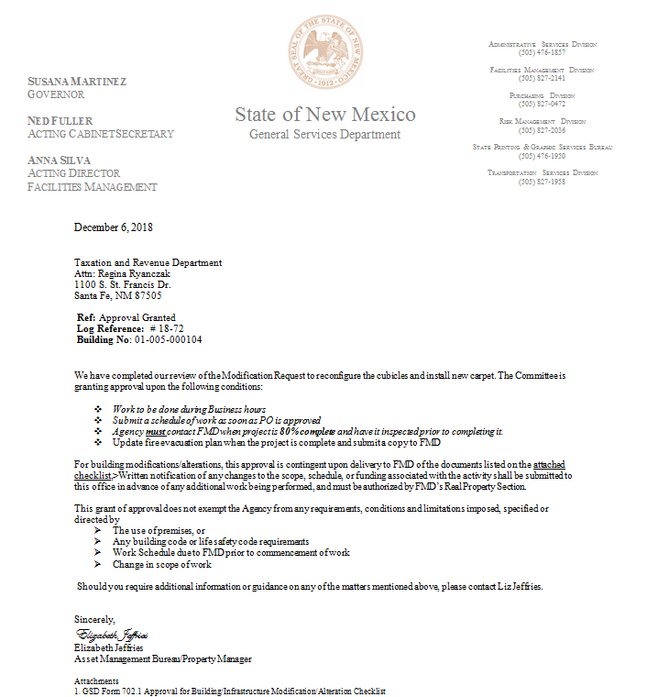
Conditional Approval
You will be issued a conditional approval letter
The letter will have conditional information specific to the agency and the project

Slide 16
You’re Approved!! ☺
You may begin working on your project (according to the Conditional Approval)
you MUST provide FMD with a schedule of work
You MUST contact FMD and the Project Manager once the project has reached 80% completion
Once the project is complete it is the responsibility of the agency to contact FMD that the Project is closed and submit after pictures.

Slide 17
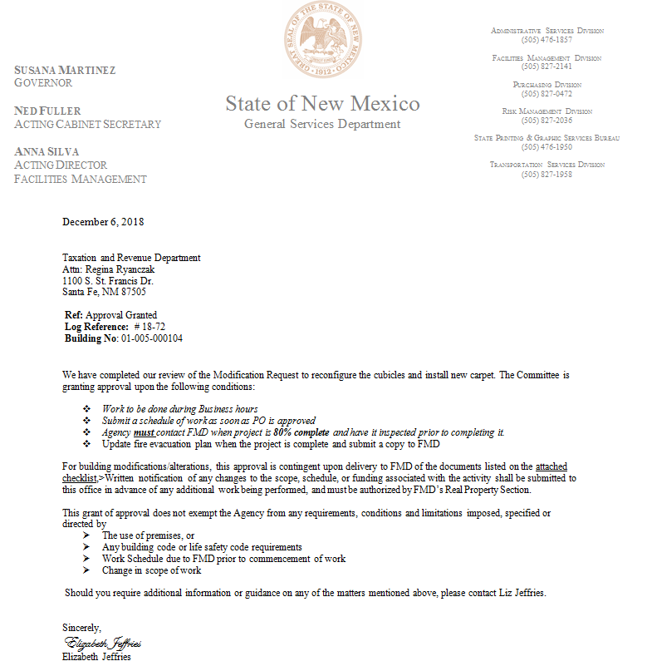
Pending a Conditional Approval Additional Information letter sent
Committee requires additional information, before making a decision on your modification request

Slide 18
Continued: Additional Information Agency Response to Letter
Agency submits all documents
Architectural Drawings
Electrical Analysis
Schematic's
Equipment
Roofing material
Modular Furniture
Committee Reviews
Moves forward with Conditional Approval or Denial

Slide 19
Denial
If the committee decides to deny your request it may be recommended for following action :
Capital project
A work order
Requires additional study

Slide 20
Thank you
We are here to assist you with questions:
Elizabeth Jeffries, Asset Management Bureau Chief,
Elizabeth.Jeffries@gsd.nm.gov
(505) 670-7423;
Martin Kuziel, Staff Architect,
Martin.Kuziel@gsd.nm.gov
(505) 795-0116
Send packets to:
Stella.Chavez@gsd.nm.gov
505-490-2313

