Slide 1
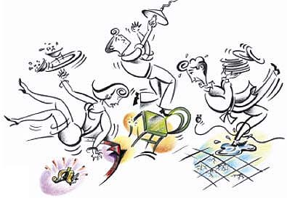
Slips, Trips & Falls
Presented by
Mike C. Perea, R.N.
Occupational Health Nurse

Slide 2
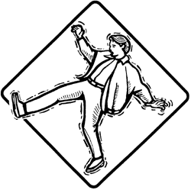
What we’ll cover
Definitions
The cost of slips, trips & falls
What OSHA says
Causes
Factors that increase the
risk of incidents
Prevention

Slide 3

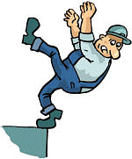
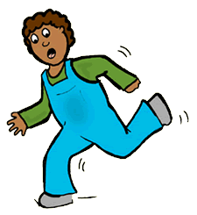
What are slips, trips & falls?
Slip
A slip occurs when there is too little traction or friction between the shoe and walking surface.
Fall
A fall occurs when you
are too far off balance.
Trip
A trip occurs when a person’s foot
contacts an object in their way or
drops to a lower level unexpectedly,
causing them to be thrown off-balance.
Notes:
Friction: The resistance encountered when an object (foot) is moved in contact with another (ground). Friction is necessary in order to walk without slipping.

Slide 4
What are slips, trips & falls?
There are two types of falls:
Same Level
From Elevation
When you fall to the
surface you are walking on. Same level falls are more common.
When you fall to a level below the one you are walking on. Falls from elevation are more severe.
Caused by:
Caused by:
Slips
Trips
Ladders
Stairs
Platforms
Loading docks

Slide 5
Slips, trips & falls occur frequently
According to the U.S. Department of Labor, slips, trips and falls are the most common occupational accident.
The Bureau of Labor Statistics reported that 253,440 employees suffered injuries falling in the work environment in 2007. Of these:
  68% suffered injuries falling at the same level
  32% suffered injuries falling to a lower level
Over 17% of disabling work injuries were caused by falls.

Slide 6
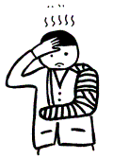
Slips, trips & falls occur frequently
15% of accidental deaths* are caused by falls, second only to motor vehicle accidents
Many of these incidents could have been prevented with general safety precautions
*work related and non-work related

Slide 7
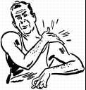
The cost of slips, trips & falls
Slips, trips and falls can occur almost anywhere at
the worksite and the incidents often have serious outcomes, resulting in debilitating injuries and even death.
pain (from bruises, sprains, strains or fractures)
lost wages
temporary or permanent disability
reduced quality of life
depression
inconvenience

Slide 8
What OSHA says
Because slips, trips and falls can occur almost anywhere and have
various causal factors, OSHA has numerous standards that address slip, trip and fall safety for different industries. CFR 1910 Subpart D covers all walking-working surfaces for general industry.
CFR 1910.22 “General requirements” specifies that:
  all areas of employment should be kept clean and sanitary
  the floors shall be kept clean and dry
  aisles and passageways shall be kept clear and in good repair
  permanent aisles and passageways shall be marked

Slide 9

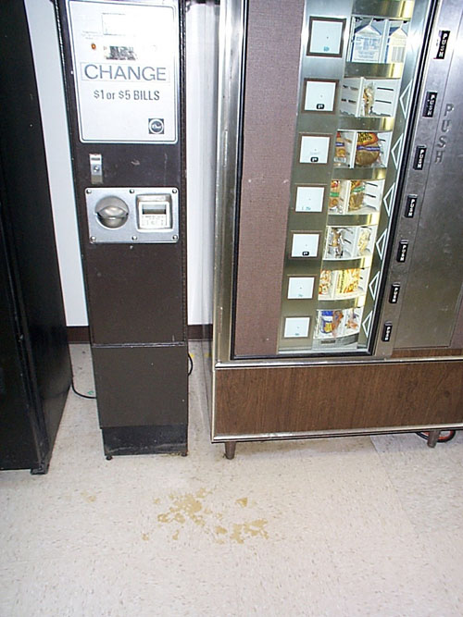
Causes of Slips
Wet spills or contamination
on floors:
water, mud, oil,
grease, food, etc.
Dry contamination
on floors:
dusts, powders, wood,
lint, plastic, etc.

Slide 10
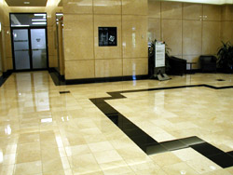
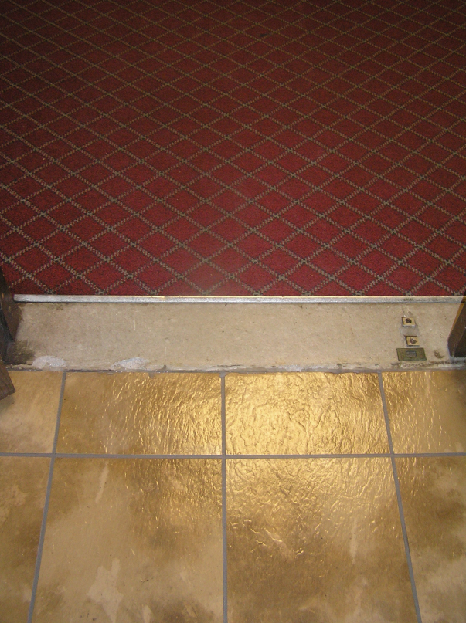
Causes of Slips
Highly polished floors
especially marble, terrazzo
or ceramic tile
Freshly waxed floors
Transitioning from one
surface to another
e.g., carpeted to a smooth
surface

Slide 11
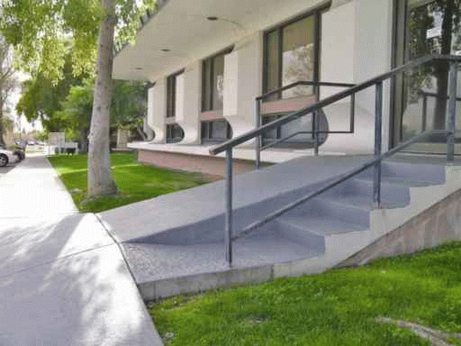
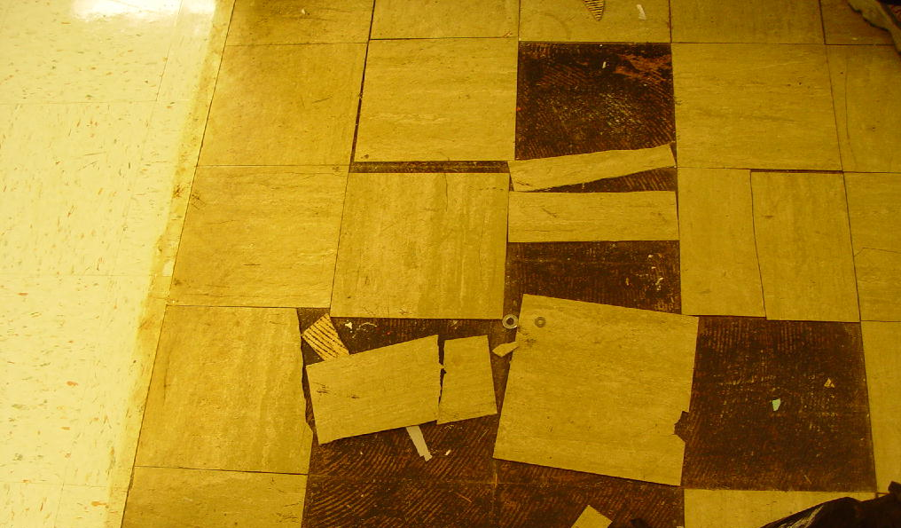
Causes of Slips
Sloped walking surfaces
Loose, unanchored mats
or rugs
Loose tiles or floorboards
that can shift
Wet, muddy or greasy
shoes

Slide 12
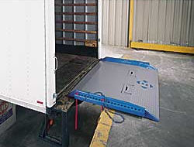
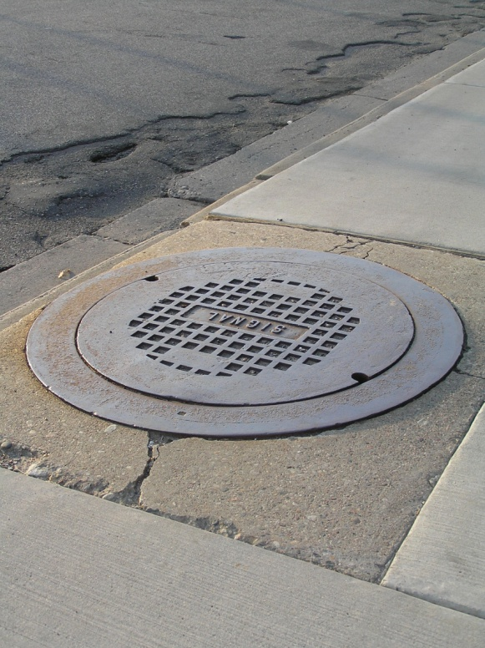
Causes of Slips
Ramps without skid or
slip resistant surfaces
Metal surfaces such as
platforms, construction
plates or covers on
sidewalks or roads
Metal has lower traction than many other surfaces, so it can become very smooth with wear, becoming even more hazardous when wet or frosty.

Slide 13

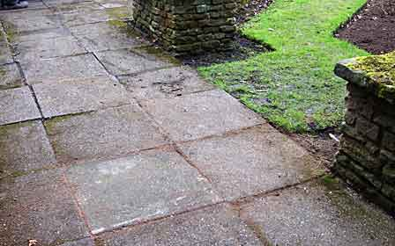
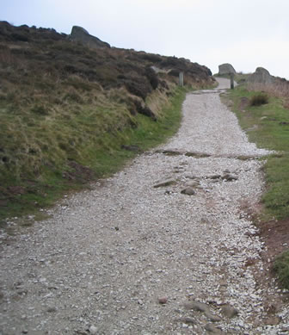
Causes of Slips
Environmental factors: rain, frost, snow, ice or humid surfaces
Uneven surfaces or terrain
Irregular surfaces, such as gravel or bricks

Slide 14
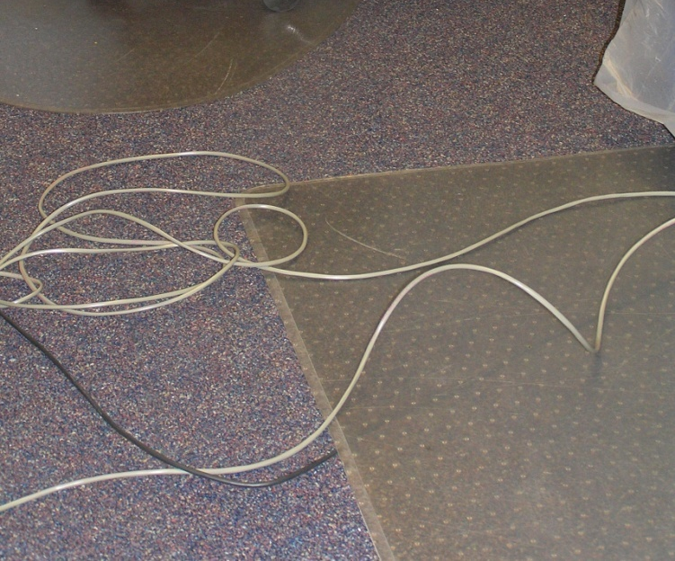
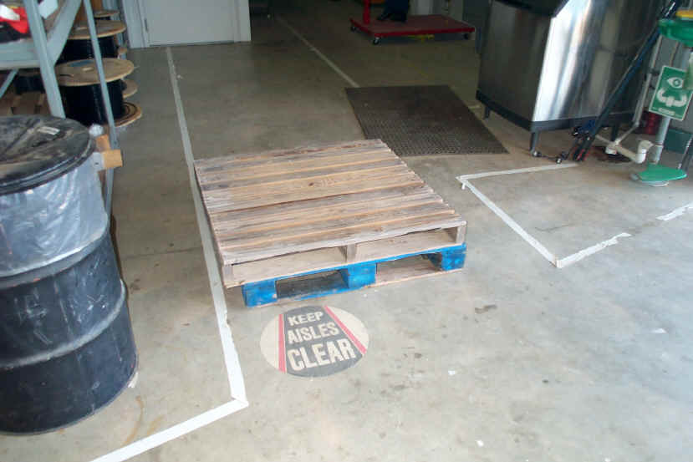
Causes of Trips
Uncovered cables, wires
or extension cords (temporary wiring)
Clutter, obstacles in
walkways
Open cabinets or desk
drawers

Slide 15
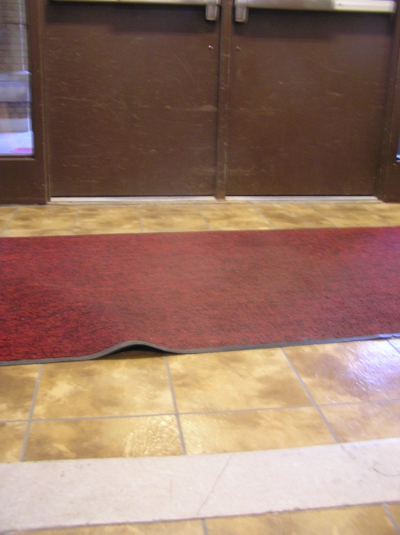
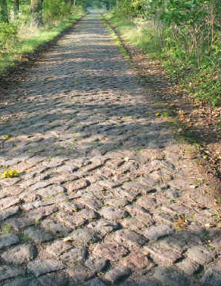
Causes of Trips
Changes in elevation,
e.g. unmarked steps
Carpets or mats that
are not lying flat or have
rolled up edges
Missing or uneven floor tiles
Irregular walking surfaces

Slide 16
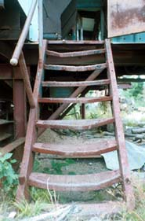
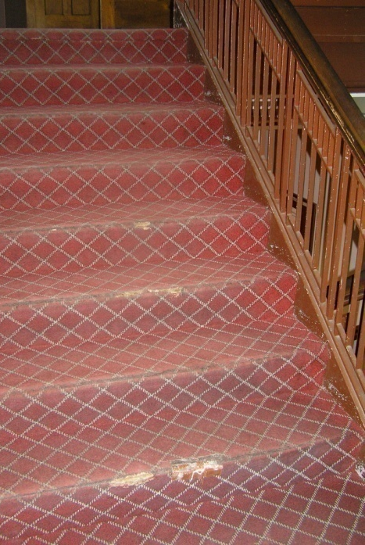
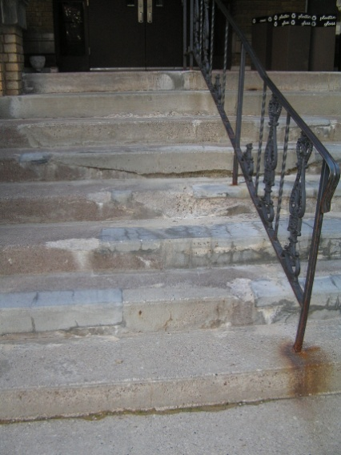
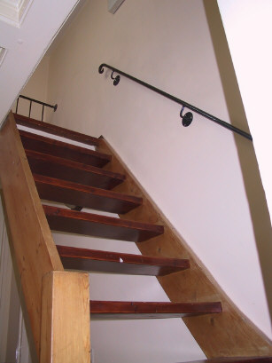
Causes of Trips
Damaged steps
Non-uniform or
irregular steps:
varying tread depth,
varying height
or otherwise uneven
Each year there are over 3 million disabling stair fall accidents, including over 4000 deaths.
Notes:
It’s estimated that 70% of stairs in public buildings have serious defects (i.e. damaged surface, uneven treads, etc.)

Slide 17
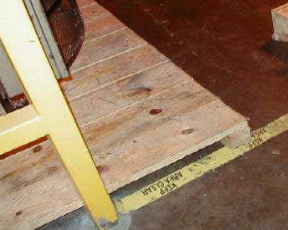
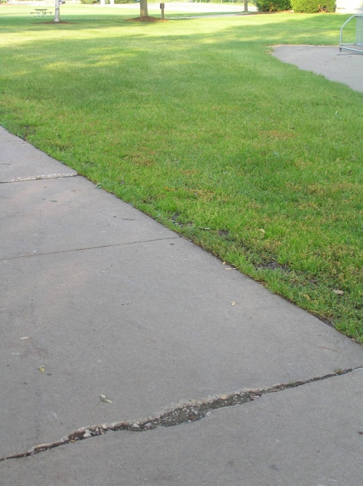
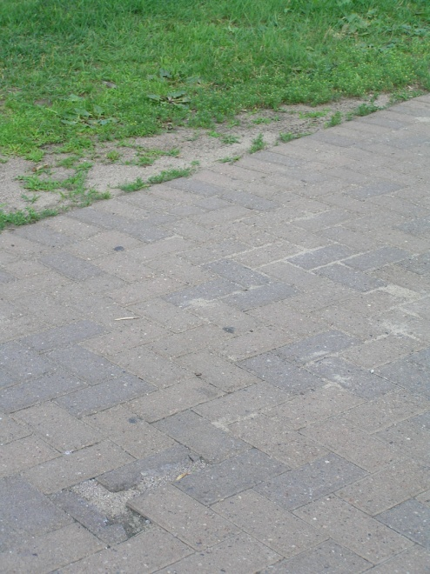
Causes of Trips
Accumulated waste materials or debris
Trailing cables, pallets,
tools, etc. in walkways
Objects protruding from
walking surface
Uneven surfaces
Sidewalk/curb drops

Slide 18
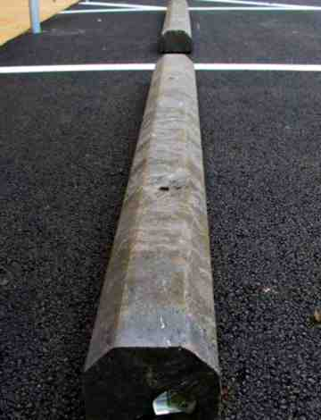
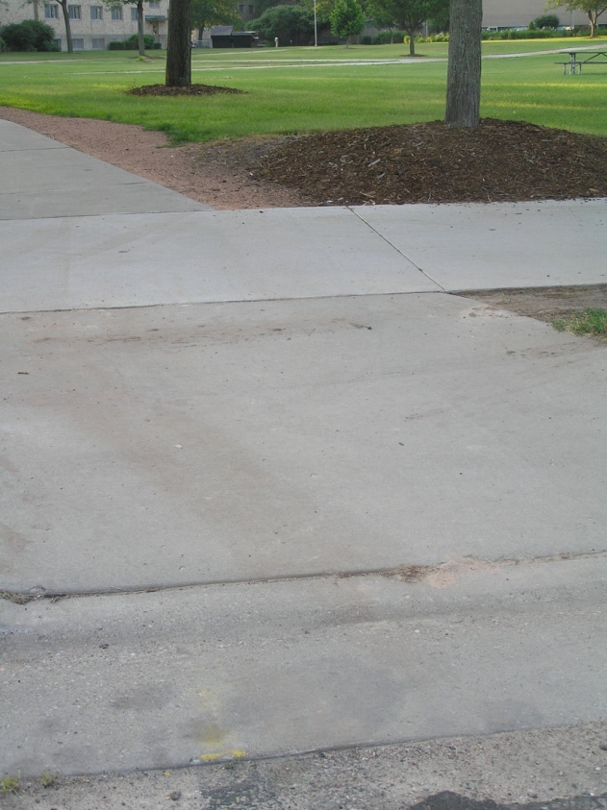
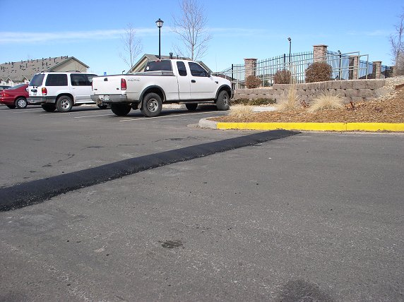
Causes of Trips
There are also numerous common trip
hazards in parking lots and garages.
Speed bumps
Tire bumpers
Wheelchair ramps

Slide 19
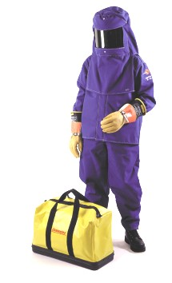

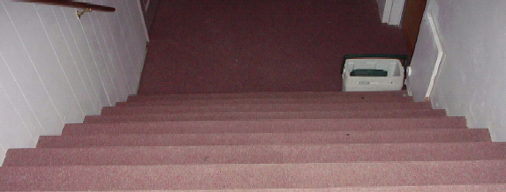
Conditions increasing the risk of slips, trips and falls
Conditions in the surrounding environment can
have a huge impact on slip, trip and fall hazards.
Poor lighting
Glare
Using bulky equipment
or awkward PPEs
Loud noise or distraction
Temperature, humidity
or precipitation
Traffic type or volume
Notes:
Conditions in the surrounding environment can have a huge impact on slip, trip and fall hazards.

Slide 20
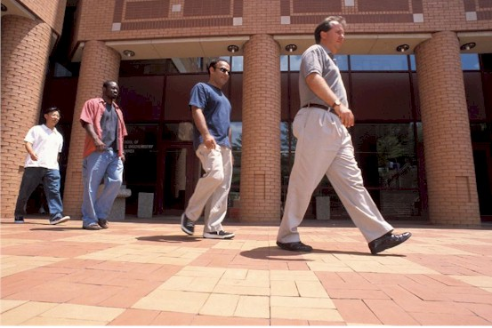


Conditions increasing the risk of slips, trips and falls
Age
Body shape, size and mass
Gait dynamics
Physical condition, illness
Psychological factors,
stress and distractions
Medications, alcohol or drug effects
Visual perception, eyesight
Notes:
Personal Factors

Slide 21
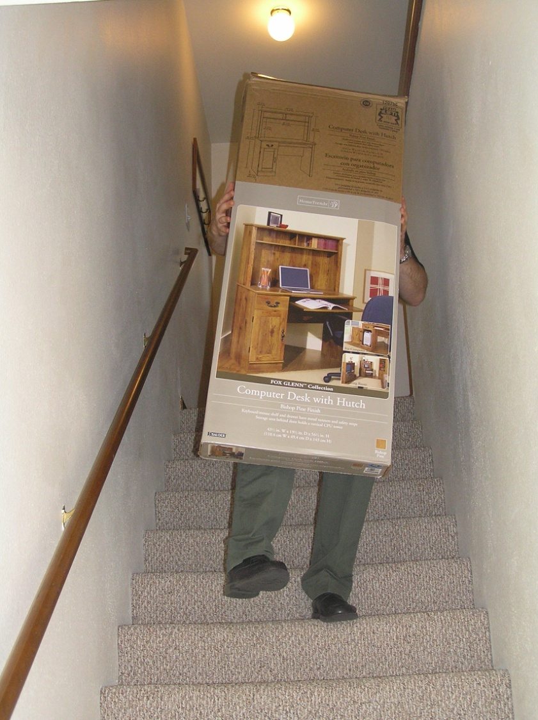
Human factors increasing the risk of slips, trips and falls
Human behaviors have an impact on the risk for accidents.
Carrying too much at once
or carrying awkward objects,
preventing you from:
  Seeing where you are going
  Holding onto railings
  Keeping your balance

Slide 22

Human factors increasing the risk of slips, trips and falls
Inattentive walking
Using a cell phone, reading, talking and not watching where you are going while walking (distracted walking)
Taking shortcuts
Not using clear pathways or
designated walkways
Being in a hurry

Slide 23
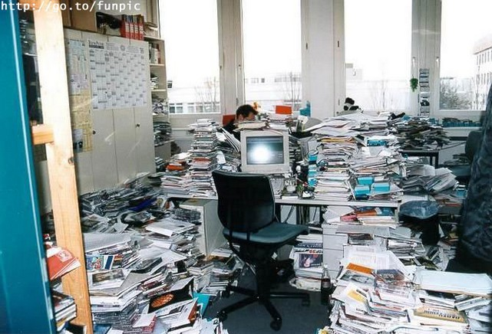
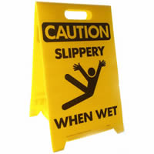


Human factors increasing the risk of slips, trips and falls
Poor housekeeping
Allowing clutter to
accumulate, not cleaning
up spills in a timely manner
Using improper cleaning
processes
Over-using wax or polish on
floors, using water to clean up
a grease spill
Failing to use signs when
slip, trip and fall hazards
are present

Slide 24
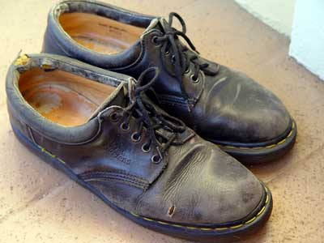
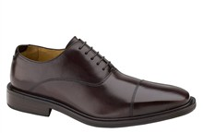
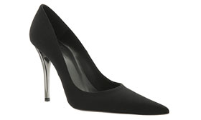
Human factors increasing the risk of slips, trips and falls
Use of footwear not suitable for
work environment or environmental conditions.
Old, worn-out
shoes
Smooth surfaced
soles
High heels

Slide 25
Slips, trips and falls are preventable!
Modify workspaces and work practices to reduce hazards – avoid distractions!
Practice good housekeeping
Wear proper footwear
Use ladders and stairs with caution
Practice safe walking procedures

Slide 26
Tips to prevent injuries from falling
Strength training with weight bearing and resistive exercise works for all age groups.
Practice exercises designed to help improve balance.
Exercise at least three days a week to improve strength, flexibility and balance.
Choose low-impact exercises, such as yoga, tai chi and Pilates to avoid stress on joints.
Stretch daily to improve flexibility and mobility.

Slide 27
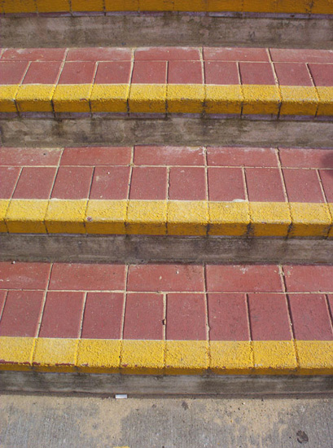
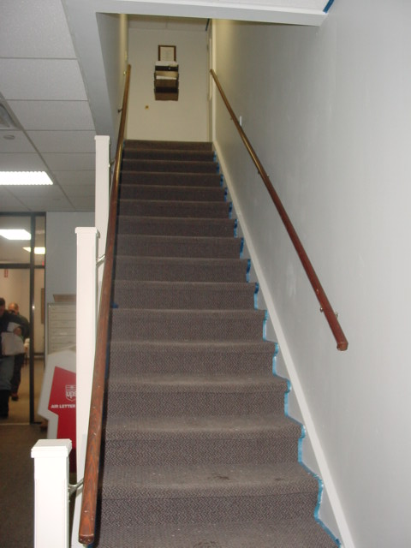
Workspace and work practice design
Highlight step edges and transitions with anti-skid paint
Make sure stairways have sufficient lighting and handrails
If stairway is not often used and not always lit, make sure access to light switches is readily available at both top and bottom or stairwell

Slide 28
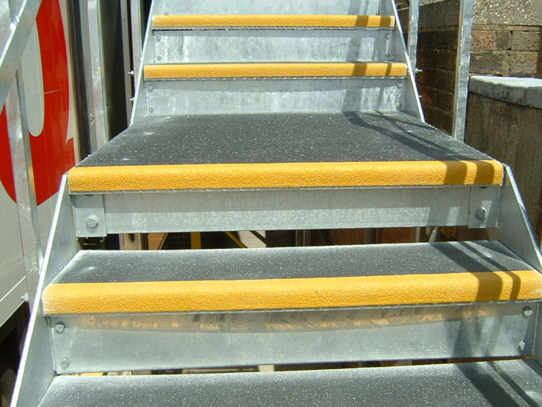
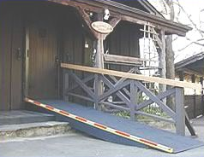
Workspace and work practice design
Use anti-slip coating and tape where applicable
Stairs with anti-skid coating and highlighted edges.
Ramp with anti-skid coating and highlighted edges.

Slide 29
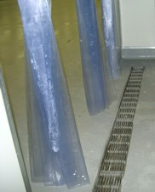
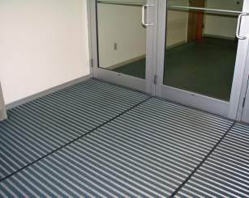
Workspace and work practice design
Use drainage or false floors where needed
Use slip-resistant floor in high risk areas like entrances

Slide 30
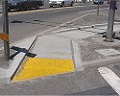
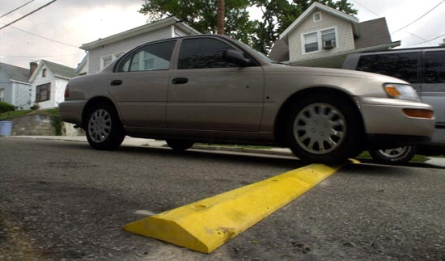
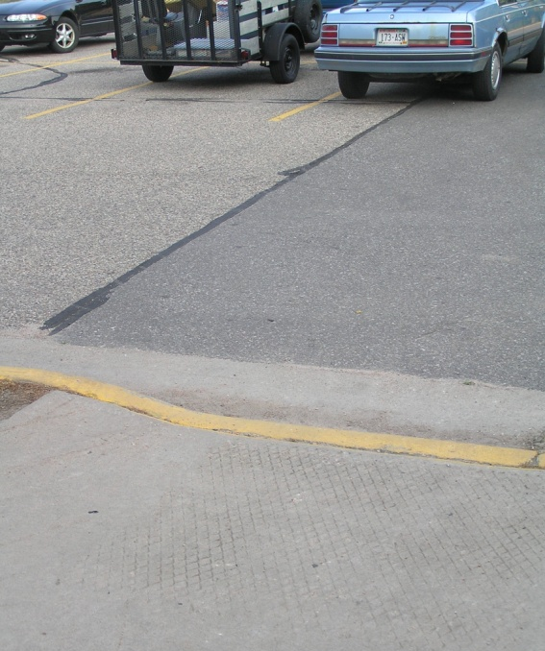
Workspace and work practice design
Highlight slip and trip hazards for better visibility

Slide 31
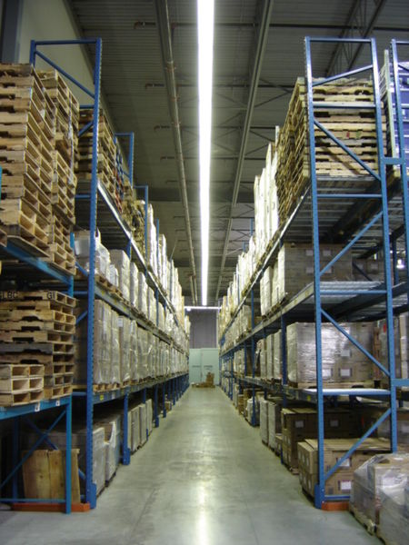
Housekeeping
Keep walkways, aisles and stairs clear of clutter
Cover or secure cords, cables, wires or hoses and keep them away from high traffic areas
Better yet, use cordless tools
Make sure rugs lay flat and secure
A warehouse with clear, well-defined walkways.

Slide 32
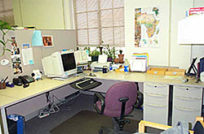
Housekeeping
Close desk, cabinet and
file drawers after use
Keep floors around the workspace free of cords, boxes, materials, papers and other objects
An clutter-free, organized office space.

Slide 33
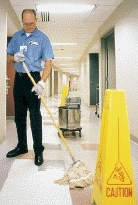
Housekeeping
Keep floors free of mud, water, grease and debris
Clean up spills immediately
Block off contaminated area and continue to use caution signs while the floor is drying
Note: Be sure not to overuse “Wet Floor” or
“Caution” signs, if they become a part
of the ‘scenery’, they may not be taken
seriously when there really is a hazard.

Slide 34


Housekeeping
Clean surface areas regularly as recommended, following appropriate cleaning and drying procedures
Repair or replace any damaged flooring as necessary

Slide 35


Safe Walking Procedures
Pay attention to your surroundings, look where you are going and pay attention to slip and trip hazards
Walk, don’t run – take your time
Don’t read, write or work while walking
Use handrails while ascending and descending stairs, take your time and don’t skip steps
Bring a flashlight with you if you are going into a dim area

Slide 36


Safe Walking Procedures
Before you lift anything, check to make sure your path is clear and your view is not obstructed
Utilize carts - don’t carry anything that you cannot see over or around
Carry small loads close to your body
Use the elevator if you are going to another level and are carrying something that requires you to use both hands

Slide 37

Safe Walking Procedures
Walk cautiously when you transition from one walking surface to another
Slow down and take small steps when a surface is cluttered, uneven or at an angle
Wear stable non-slip shoes

Slide 38
Safe Walking Procedures
If you must walk on a slippery surface:
Wear non-slip footwear
Pay attention to the surface you are walking on
Take small, slow steps
Point your feet out slightly to keep your center of balance under you
Use handrails or other stable objects you can hold onto

Slide 39
If you find yourself falling
Bend your elbows and knees and use your legs and arms to absorb the fall.
Protect the vulnerable parts of your body, like the head, neck and spine.
Don’t move if you think you’ve hurt yourself. Wait for help.
Notes:
Slap the ground with your hand and extended fingers to absorb impact

Slide 40

Rules of Thumb…
If you drop it, pick it up.
If you spill it, wipe it up.
Go where you are looking,
and look where you are going.
There is always time for safety !

Slide 41


Slide 42


