Slide 1
New Mexico state LOSS PREVENTION & CONTROL PROGRAM overview
General Services Department
Risk Management Division
Loss Control Bureau

Slide 2
Organizational Structure
Risk Management Division
AJ Forte
Director
Loss Control Specialist
Pedro Archuleta
Loss Control Specialist
Adreien Jaramillo
Loss Control Specialist
Vacant
Loss Control Bureau
Norbert E. Archibeque
Bureau Chief

Slide 3
The Loss Prevention and Control Bureau
Services Provided:
  Assist Agencies with compliance with the NMAC 1.6.4 - Loss Prevention and Control Rule
  Provide quarterly loss run reports of Agency claims history
  Provide in-depth Agency analysis of claims history
  Identify trends of claims history to accurately provide recommendations to pinpoint sections within your Agency
  Provide training to Agency personnel and management
    Training can be Agency specific
    Training can be open to all Agencies
Notes:
Compliance of the 142 RMD insured entities.

Slide 4
Training Opportunities
Ergonomic
  Awareness
  Assessor
  General Back Safety and Lifting Procedures
Workers’ Compensation 101
Property and Casualty 101
Workplace Blood Borne Pathogen
General Office Safety
Fine Arts Security and Claims Process
Boiler and Machinery Safety

Slide 5
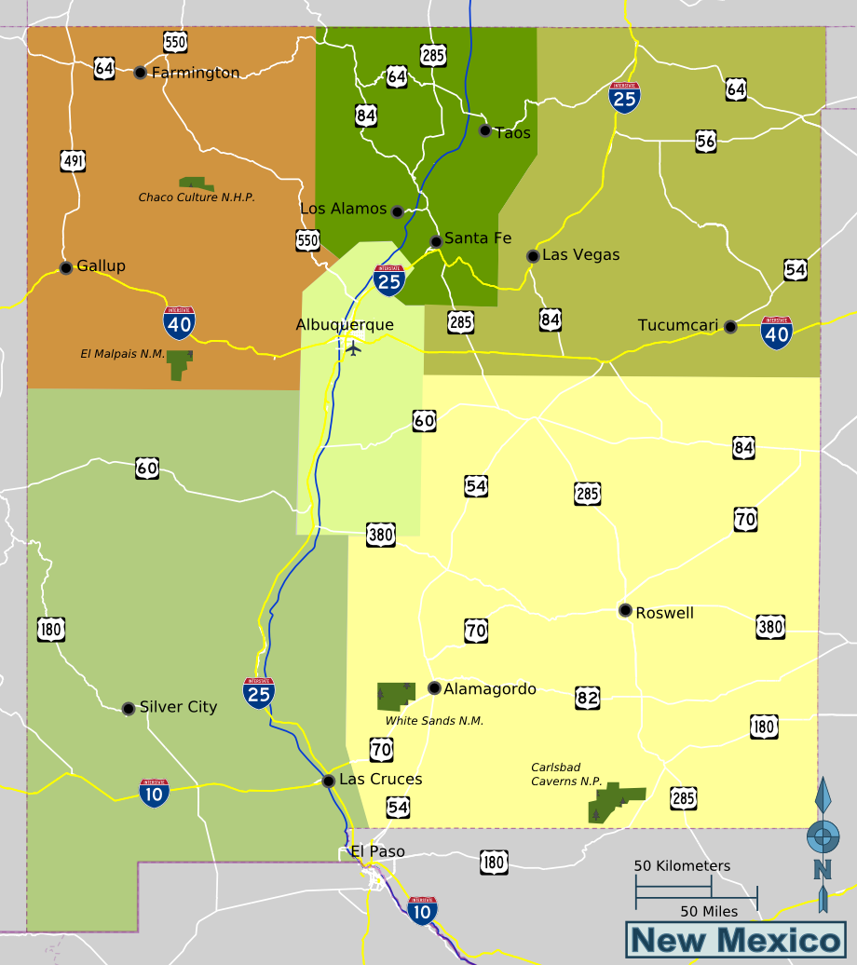
GSD-RMD-LCB Agency SUPPORT MAP
As of: 1 March 2014
Pedro
Vacant
Adreien
11100 - LC
40400 -AEB
11200 - LFC
41800 - TD
23800 – 8th JDC
66200 – MCMC
11400 - SI
51600 - DGF
24100 – 11th JDC
25800 – 8th JDA
93100 – HPREC
11500 - HI
52100 - ENMRD
26100 – 11th JDA Div I
Aztec
11700 - LESC
52200 - YCC
96400 - SJCC
11900 - LCBS
20800 - NMCC
Raton
13100 - NMLS
60900 - DIA
13101 - NMSS
63000 - HSD
13101 - NMSS
55000 - OSE
13102 - NMHS
13102 - NMHS
67000 - VSC
33700 - SIC
33700 - SIC
80500 - NMDOT
34100 - DFA
96300 - NNMC
34100 - DFA
37800 - SPO
35200 - ERB
35200 - ERB
38500 - NMFA
35500 - PDD
26500 – 11th JDA Div II
Española
35500 - PDD
50500 - DCA
21500 - COA
21500 - COA
21800 - AOC
92400 - PED
24300 – 13th JDC
23400 – 4th JDC
93300 – NEREC
21800 - AOC
21900 - SCBC
Rio Rancho
26300 – 13th JDA
25400 – 4th JDA
95700 – NMHU
21900 - SCBC
60600 - CDHH
Bernalillo
23100 - 1ST JDC
100740 - SRMC
Grants
23100 - 1ST JDC
20500 - SCLL
25100 - 1ST JDA
25100 - 1ST JDA
64700 - DDPC
30500 - OAG
23200 – 2ND JDC
60300 - OAAA
Santa Rosa
24000 – 10TH JDC
30500 - OAG
66700 - NMED
23200 – 2ND JDC
30800 - OSA
24400 - BCMC
60500 – MLK Jr
Belen
26000 – 10TH JDA
30800 - OSA
66500 - DOH
24400 - BCMC
33300 - TRD
25200 – 2ND JDA
46000 - NMSFC
Clovis
33300 - TRD
92700 - NMSD
25200 – 2ND JDA
35000 - GSD
26400 - AODA
50800 - NMLB
35000 - GSD
70500 - DMA
21600 - NMSC
23900 – 9th JDC
21600 - NMSC
35400 - NMSC
63100 - DWS
21600 - NMSC
53900 - SLO
21000 - JSC
25900 – 9th JDA
21000 - JSC
46500 - NMGCB
63200 - WCA
21000 - JSC
62400 - ALTSD
35600 - GO
35600 - GO
46900 - NMSRC
66800 - ONRT
Portales
35600 - GO
64400 - DVR
36000 - LtGO
36000 - LtGO
47900 - NMVMB
76500 - JPB
36000 - LtGO
64500 - GCOD
36100 - DOIT
95500 – ENMU
36100 - DOIT
94000 - PSFA
78000 - CVRC
36100 - DOIT
69000 - CYFD
96900 - UNM
96901 - UNMH
23700 – 7TH JDC
Ruidoso
36600 - PERA
76000 - APB
21400 - SBE
34300 - RHCA
25700 – 7TH JDA
Socorro
36900 - SRCA
77000 - DOC
60100 - CSW
37900 - PELRB
95900 - NMIMT
37000 - SOS
79000 - DPS
60400 - CDHH
44900 - NMBON
93200 – REG IX EC
41900 - EDD
79500 - DHSEM
66900 - NMHPC
93000 - CREC
42000 - RLD
95000 - NMHED
56900 - NMOCC
93400 - SWREC
43000 - PRC
44000 - OSI
23600 – 6TH JDC
T or C
39400 - STO
44600 - BME
25600 – 6TH JDA
24200 – 12th JDC
46400 - BPES
40000 - WRHA
26200 – 12th JDA
96100 - NMMI
96200 - WNMU
96500 – NMSVI
23500 – 5th JDC
25500 – 5th JDA
23300 – 3RD JDC
95600 – ENMU
25300 – 3RD JDA
Santa Theresa
3000 - ERHA
49500 - SA
41700 - NMBA
95300 - NMSU
95390 - SCNMCBWC

Slide 6
1.6.4 NMAC Loss Prevention and Control Rule
Understanding Compliance

Slide 7
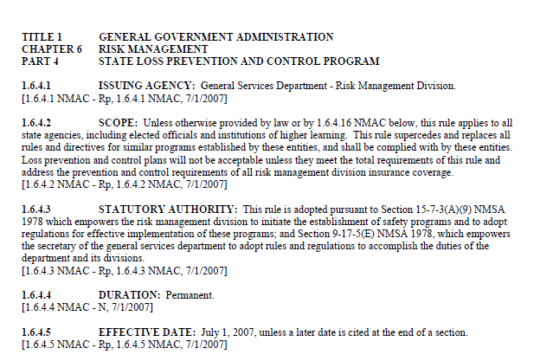
Creation of Loss Prevention & Control Program
1.)
NMAC Rule 1.6.4
2.)
Who is under the Rule?
3.)
Rule Effective Date

Slide 8
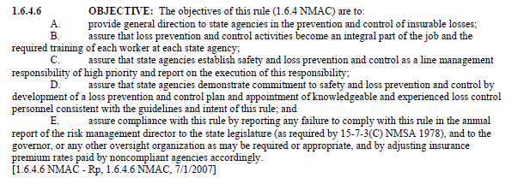
Loss Prevention & Control Program Objectives

Slide 9
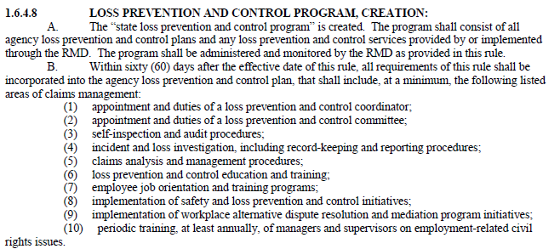
Loss Prevention & Control Program Creation

Slide 10

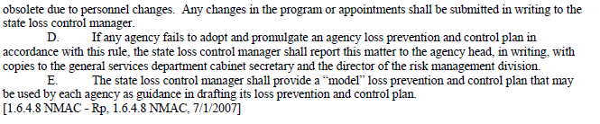
Loss Prevention & Control Program Creation (continued)

Slide 11
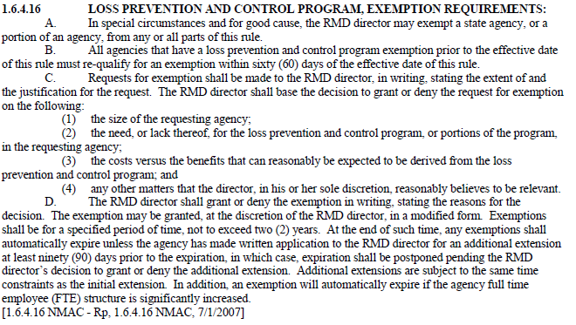
Loss Prevention & Control Program Exemption

Slide 12
Building an Effective Program,
One Supporting Column at a time…
Loss Prevention and Control Program
Management Support
LP&C Committee
LP&C Plan
Training
1.6.4 NMAC Loss Prevention and Control Rule

Slide 13
Seven Components of a Loss Prevention and Control Program
Top Management
  Commitment
  Support
Reporting Losses and Investigating
Inspections
Recordkeeping
Analysis
Intervention
  Education and Training
  Engineering
  Equipment
  Enforcement
  Programs
Program Review

Slide 14
Potential Benefits of a Functional
Loss Prevention & Control Program
Lower insurable losses (insurance claims)
Increase budget to Agency through lower premium payments
Increase morale = Increase productivity
Increase employee and employer knowledge of safety
Increase awareness

Slide 15
1.6.4.10 LOSS PREVENTION AND CONTROL COMMITTEE, DUTIES:
“Loss prevention and control committee” shall be created in each state agency, Agencies’ may provide for committees at division or other appropriate levels.
The head of an agency shall appoint the committee members.
Each committee shall elect a chairperson and a secretary annually.
Each committee shall hold meetings at least quarterly.
  Secretary shall keep meeting minutes
  Minutes shall be approved and signed by the agency head
  Forward minutes to the state loss control manager within thirty (30) days meeting

Slide 16
1.6.4.10 Continued
Each agency head shall establish the agency committee’s duties and shall include, but are not limited to the following:
  (1) compile, analyze, and evaluate agency loss information to ensure adequate measures are being taken to prevent recurrence of the same or similar losses
  (2) establish, evaluate and make recommendations for improvement of agency loss prevention and control activities
  (3) perform any other functions the committee considers useful and appropriate, and which are consistent with the agency loss prevention and control plan

Slide 17

Focusing on Loss Prevention

Slide 18
What the LPC Committee is NOT
  The Safety Police
  Enforcement – All about Compliance
  Slander Employees
  Autocratic – Democratic, Open Discussion without Repercussions
  Social Club – All about Cost-Avoidance
  “Silly” or “Stupid” additional duties that have no benefit

Slide 19
Trends Analysis = Training Program
WC Loss Drivers FY09 – FY13

Slide 21
PAC Loss Drivers
FY09 – FY13

Slide 23
Conclusion
Alone, we cannot accomplish the intent of the State Loss Prevention
& Control program
However,
  As a team with a strong foundation and support from our leaders
  We Can
    Save Lives
    Save Money (Insurance Premiums)
    Resolve Solvency Issues (Budgets)
  Together we can make a difference
  Together we will make a difference

Slide 24
Questions?

Slide 25
The Loss Prevention and Control Bureau
The State Loss Prevention and Control Manager:
Norbert E. Archibeque - (505) 476-2177
State Loss Prevention and Control Specialists:
Vacant - (505) 827-2593
Adreien Jaramillo, CEAS I & III - (505) 827-3296
Pedro Archuleta - (505) 827-2166

