Slide 1
General Office Safety
Created by,
State of NM Loss Control Bureau Specialists

Slide 2
THE GENERAL DUTY CLAUSE
SECTION 5(a)1 “DUTIES” THAT:
(a) Each Employer –
(1) Shall Furnish to each of his employees employment and a place of employment which are free from recognized hazards that are causing or are likely to cause, death or serious physical harm to his employees

Slide 3
THE GENERAL DUTY CLAUSE
(2) Shall comply with occupational safety and health standards promulgated under this Act.

Slide 4
THE GENERAL DUTY CLAUSE
(b) Each employee shall comply with occupational safety and health standards and all rules, regulations, and orders issued pursuant to this Act which are applicable to his own actions and conduct.

Slide 5
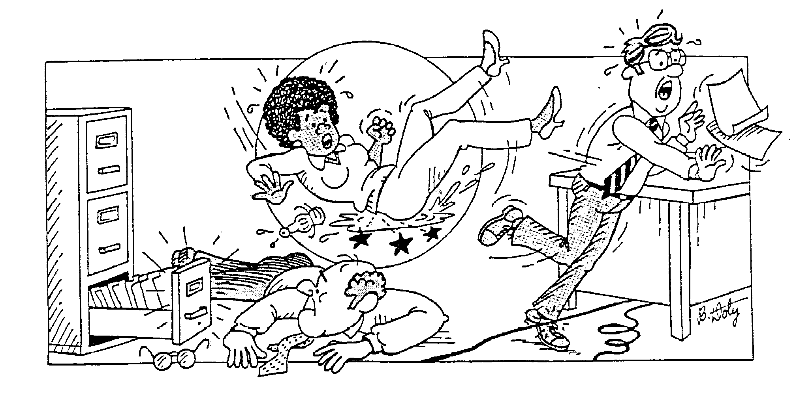
Safe Work Practices
Good housekeeping is essential.
Never store items under your desk.
Never store items on top of cabinets.
Never leave desk or cabinet drawers open.

Slide 6
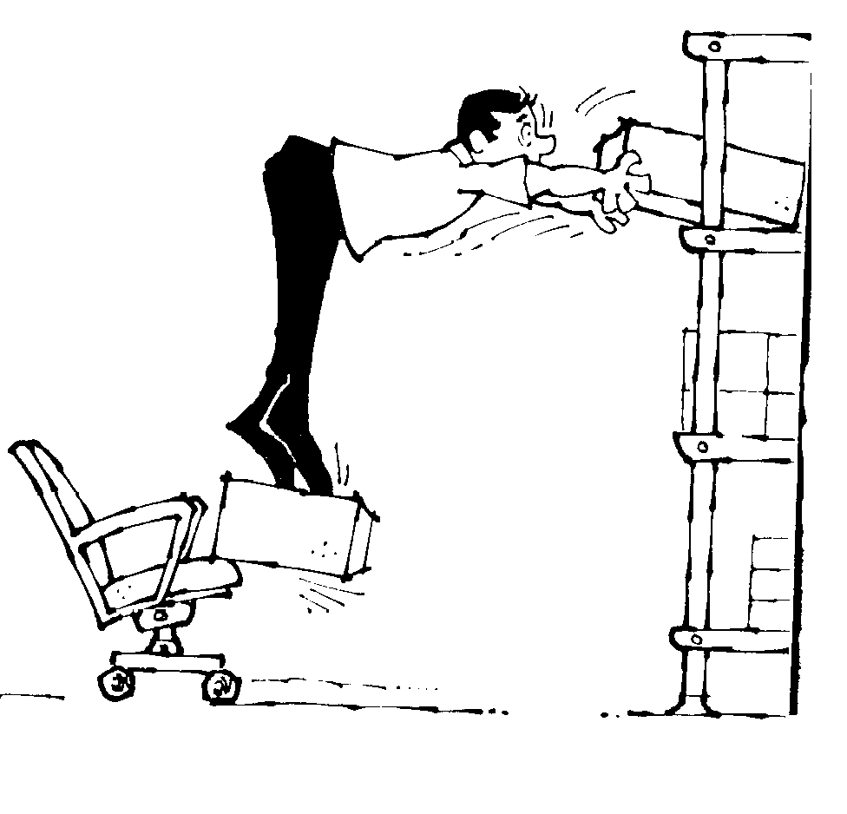
Safe Work Practices
Never stand on the chair or table to reach anything.
The top of your computer should be at eye level to avoid neck strain.
Keep aisles, hallways, and corridors clear.
Use safe lifting practices. Bend your knees!

Slide 7

Electrical Safety
Loose lying cables can cause:
  Tripping hazards
  Electrocution
  Damage to equipment
Do not use frayed extension cords!

Slide 8
Accident Reporting
Report all accidents to your supervisor!
Watch out for unsafe conditions, and report them to your supervisor!

Slide 9
Preventing Slips, Trips, and Falls
Do NOT allow cabling to create a tripping hazard.
Clean up spills quickly
Do NOT block passageways
Keep office areas clean
Keep stacking and storage areas safe

Slide 10

Office Equipment Safety
Learn how to operate before using them.
Loose clothing, jewelry, and long hair should be kept out of machines
Keep hands and fingers clear of paper inlet on shredder
Switch machines off before trying to clear a blockage.

Slide 11
Common Office Chemicals
Cleaning Agents (Bleach/Ammonia)
Toners
Inks
Cleansers
Solvents
Paints
Adhesives
These are several examples of several common chemicals that could be introduced into the workplace.

Slide 12
Hazard Communication Standard (HazCom)
Because the “Right-to-Know” Law gives you the right to know the hazards in your workplace, a written Hazard Communication Plan is required by 29 CFR 1910.1200.

Slide 13
Emergency Action Plan
An Emergency Action Plan (EAP) is needed to provide a carefully prepared guideline of appropriate response actions for a wide array of emergency scenarios. The purpose of this plan is to save lives, reduce the incidence of personal injury, and prevent property damage.

Slide 14
Fire Procedures
Evacuate the building to your designated rally points.
Your emergency action plan can help you identify your designated rally point.
At rally point, follow accountability procedures given by your plan.

Slide 15
Emergency Evacuations
Keep your head!
Know the exits!
Do not run to exits, but walk to exits!
Ensure easy access to the safest way out!

Slide 16
First Aid
Make sure that you know the location of the nearest First Aid Kit.
Make sure that the First Aid Kit is stocked properly.
Information on locations and supplies for First Aid Kits should be listed on the Emergency Action Plan.

Slide 17

Bloodborne Pathogens
The Bloodborne Pathogens Standard (29 CFR 1910.1030) helps prevent exposure to HIV & HBV.
Use Universal Precautions to prevent the spread of Bloodborne Infection.
Refer to your agency Exposure Control Plan.

Slide 18

Employee Safety
You are responsible for your own safety!
Safety is a right not a privilege!

Slide 19
The End

